Slide 1

7th Grade Math
Unit 6, Lesson 9 Exploring Multi-Step Proportion Problems Volume 1, pg. 277

Slide 2


Benchmarks
MA.7.AR.3.2
Apply previous understanding of ratios to solve real-world problems involving proportions.
MA.7.AR.3.3
Solve mathematical and real-world problems involving the conversion of units across different measurement systems.
MA.7.AR.4.5
Solve real-world problems involving proportional relationships.
volume 1, pg. 277

Slide 3
Integrated Mathematical Thinking and Reasoning Standards
MA.K12.MTR.1.1 Actively participate in effortful learning both individually and collectively.
MA.K12.MTR.4.1 Engage in discussions that reflect on the mathematical thinking of self and others.
volume 1, pg. 277

Slide 4

Learning Target
I can solve multi-step problems involving proportions.
volume 1, pg. 277

Slide 5

Warm-Up
volume 1, pg. 278

Slide 6
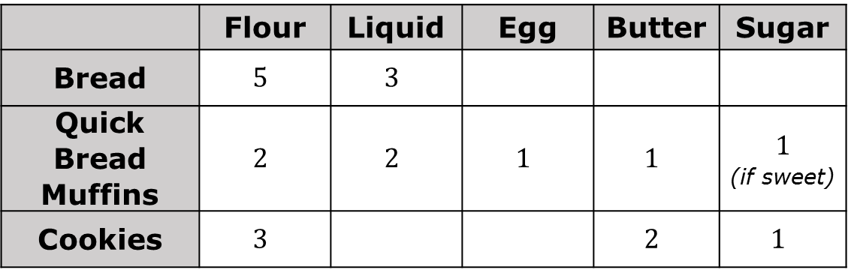
6.9.1 Warm-Up: Baking with Ratios
Chef and author Michael Ruhlman makes baking easier by using simple mathematical ratios. He uses the following chart where each number represents the number of parts of that ingredient needed for the base recipe.
 | Flour | Liquid | Egg | Butter | Sugar
Bread | $$5$$ | $$3$$
Quick Bread Muffins | $$2$$ | $$2$$ | $$1$$ | $$1$$ | $$1$$ (if sweet)
Cookies | $$3$$ |  |  | $$2$$ | $$1$$
volume 1, pg. 278

Slide 7
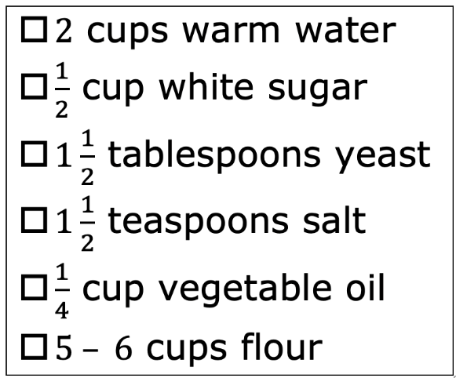
Michael Ruhlman believes, “If you know ratios, it’s like knowing a thousand recipes.” What do you think he meant by this?
The ingredients for a homemade bread recipe are shown to the right. Do the ratios in the recipe match the ratios Michael recommended for bread? Explain your reasoning.
volume 1, pg. 278

Slide 8

Guided Instruction
volume 1, pg. 278

Slide 9

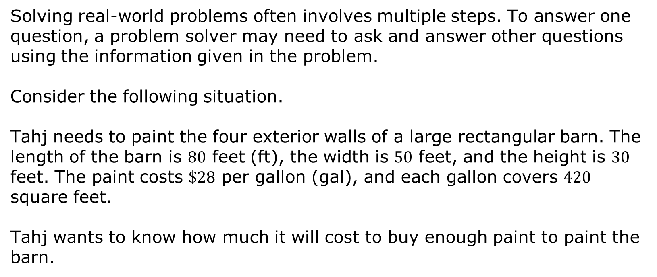
6.9.2 Guided Instruction: Thinking Through Multiple Steps
Solving real-world problems often involves multiple steps. To answer one question, a problem solver may need to ask and answer other questions using the information given in the problem.
Consider the following situation.
Tahj needs to paint the four exterior walls of a large rectangular barn. The length of the barn is $80$ feet (ft), the width is $50$ feet, and the height is $30$ feet. The paint costs $\$28$ per gallon (gal), and each gallon covers $420$ square feet.
Tahj wants to know how much it will cost to buy enough paint to paint the barn.
volume 1, pg. 278

Slide 10
Complete the questions that Tahj needs to answer before she can determine the cost. Then, find the answer to each question in the workspace provided.
Question | Workspace
What is the total _____ Tahj needs to paint, in square feet?
How many __________ of paint will be needed to cover this area?
volume 1, pg. 278

Slide 11
How much will it cost Tahj to buy enough paint to paint the barn?
Place a star next to any questions you answered using a proportion or proportional thinking.
Studying mathematics includes making connections between concepts when solving problems. In addition to proportional thinking, what other math concept(s) did you use to solve this problem?
volume 1, pg. 279

Slide 12

Collaboration
volume 1, pg. 279

Slide 13

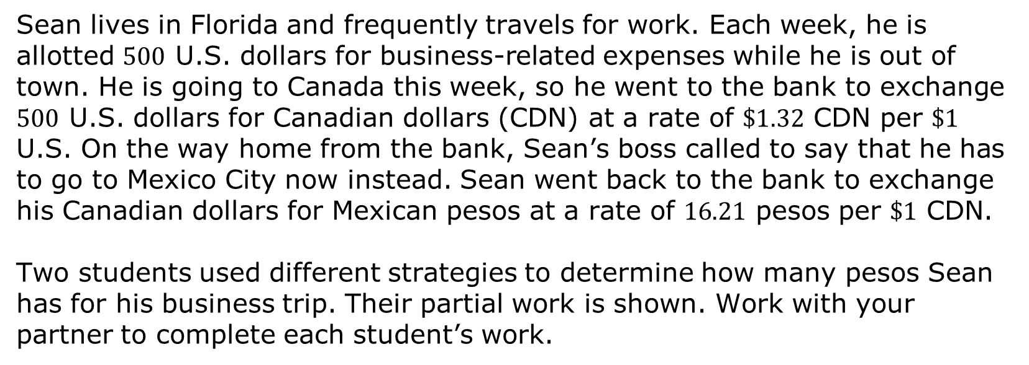
6.9.3 Collaboration: Thinking Through Multiple Steps
Sean lives in Florida and frequently travels for work. Each week, he is allotted $500$ U.S. dollars for business-related expenses while he is out of town. He is going to Canada this week, so he went to the bank to exchange $500$ U.S. dollars for Canadian dollars (CDN) at a rate of $\$1.32$ CDN per $\$1$ U.S. On the way home from the bank, Sean’s boss called to say that he has to go to Mexico City now instead. Sean went back to the bank to exchange his Canadian dollars for Mexican pesos at a rate of $16.21$ pesos per $\$1$ CDN.
Two students used different strategies to determine how many pesos Sean has for his business trip. Their partial work is shown. Work with your partner to complete each student’s work.
volume 1, pg. 279

Slide 14
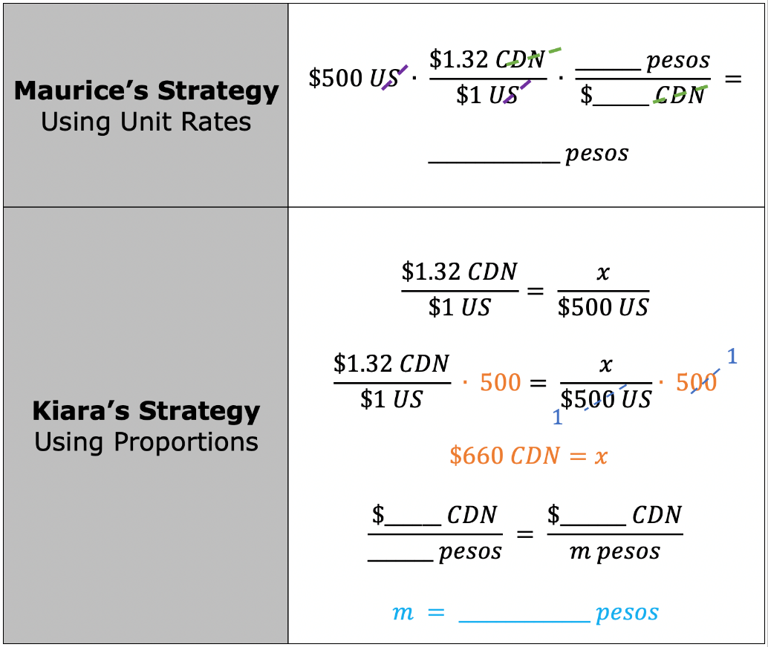
volume 1, pg. 279

Slide 15
Draw an asterisk (*) next to the part of each student’s work that represents Sean converting his U.S. dollars to Canadian dollars.
Draw a smiley face (☺) next to the part of each student’s work that was used to determine the number of pesos Sean has for his business trip.
Both students used proportional reasoning to solve the problem in multiple steps. Which method do you prefer? Explain.
volume 1, pg. 280

Slide 16

Try It
volume 1, pg. 280

Slide 17

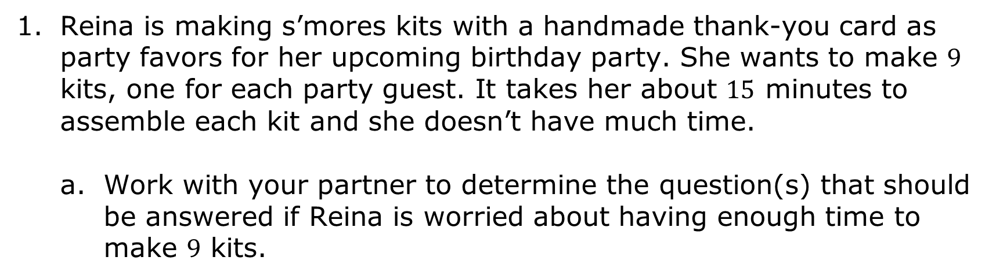
6.9.4 Try It: Solving Multi-Step Problems with Proportions
Reina is making s’mores kits with a handmade thank-you card as party favors for her upcoming birthday party. She wants to make $9$ kits, one for each party guest. It takes her about $15$ minutes to assemble each kit and she doesn’t have much time.
Work with your partner to determine the question(s) that should be answered if Reina is worried about having enough time to make $9$ kits.
volume 1, pg. 280

Slide 18
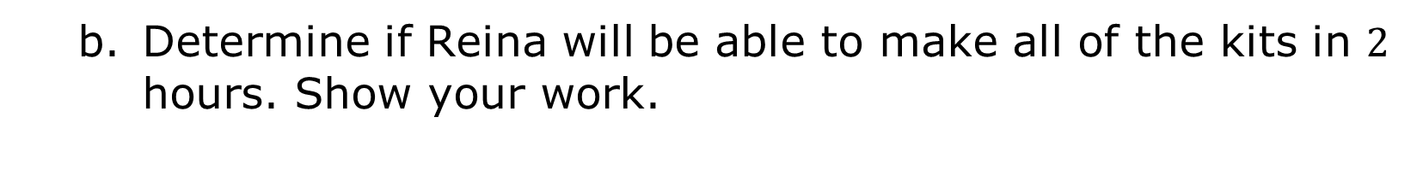
Determine if Reina will be able to make all of the kits in $2$ hours. Show your work.
volume 1, pg. 280

Slide 19
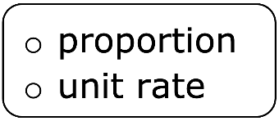
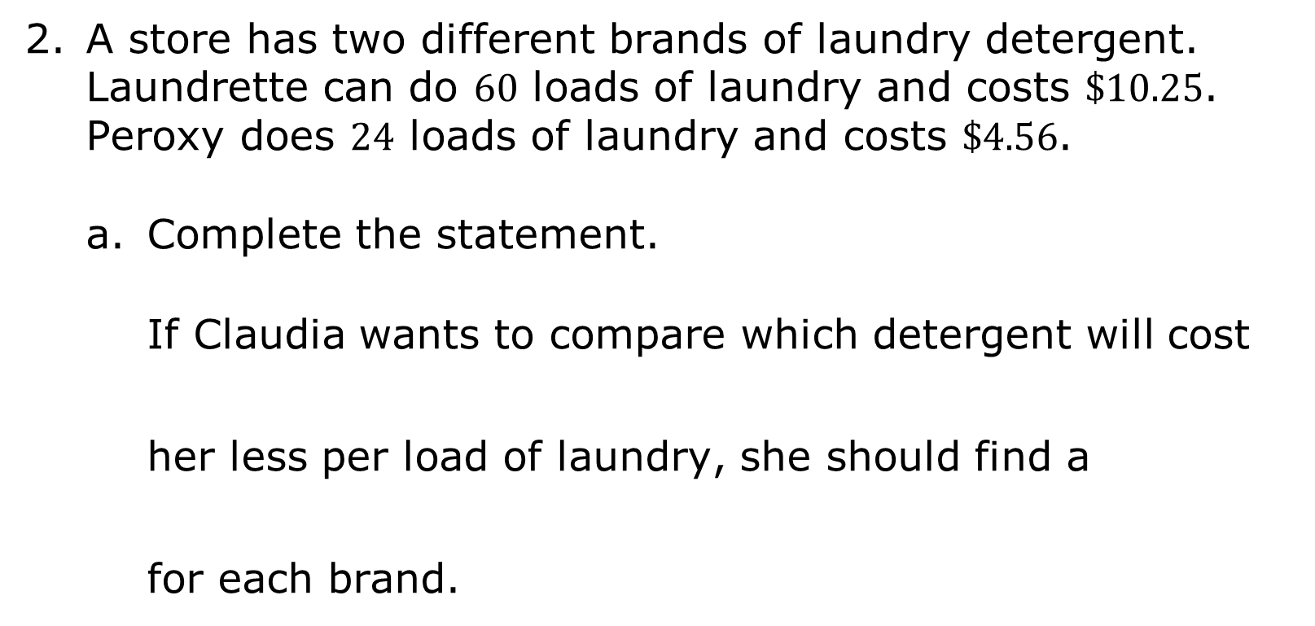
A store has two different brands of laundry detergent. Laundrette can do $60$ loads of laundry and costs $\$10.25$. Peroxy does $24$ loads of laundry and costs $\$4.56$.
Complete the statement.
If Claudia wants to compare which detergent will cost her less per load of laundry, she should find a for each brand.
volume 1, pg. 281

Slide 20
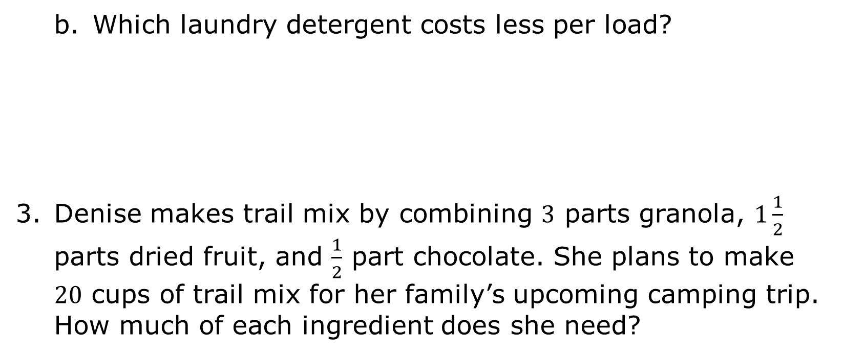
Which laundry detergent costs less per load?
Denise makes trail mix by combining $3$ parts granola, $1\frac{1}{2}$ parts dried fruit, and $\frac{1}{2}$ part chocolate. She plans to make $20$ cups of trail mix for her family’s upcoming camping trip. How much of each ingredient does she need?
volume 1, pg. 281

Slide 21
Collaboration
volume 1, pg. 281

Slide 22
6.9.5 Collaboration: Comparing Thinking
With your partner, find another pair of partners to make a group of four.
Discuss and compare your work on the Try It problems. Verify your answers and resolve any differences. If necessary, revise your work.
volume 1, pg. 281

Slide 23

Wrap-Up
volume 1, pg. 282

Slide 24
6.9.6 Wrap-Up: Growth Mindset
There is power in believing you can improve. Complete each statement based on your learning today.
Today, I am still unsure about …
I will try to build my confidence by …
volume 1, pg. 282

